Slide 1
Awareness
Beware. Your data is out there.
2023

Slide 2
Disclaimer & Laws

Slide 3

Disclaimer Boring but necessary
Information in this presentation is intended for educational and awareness purposes only.
Live presentation. Not a controlled environment and some contents may be inappropriate for some users.
I accept no responsibility in any kind for the use, misuse, downloading, viewing in whatever way the links in this presentation.
This presentation is not related to my work or employer.

Slide 4
Disclaimer Avoid illegal activities
Some links, websites, software or other items listed may or may not be legal, illegal, a felony, misdemeanor, or worse, in your country.
Please make sure that you are allowed to browse the websites, download links and software BEFORE USING!
Ignorance about laws or rules is no excuse for illegal activities or wrongdoing.
Illegal activities may get you in trouble or arrested.
Always check what is legal, and what laws apply.

Slide 5
Laws Portuguese Law and Organizations
Laws
Diário República Eletrónico (link)
ANACOM (link)
Organizations
CNCS – Centro Nacional de Cibersegurança (link)
Incident Notification (link)
CERT.PT (link)
Unidade Nacional de Combate ao Cibercrime e à Criminalidade Tecnológica (UNC3T) (link)
Ministério Público (link)

Slide 6
OSINT Time
Notes:
OK

Slide 7
OSINT – Open-source intelligence Digital Footprint
Open-source intelligence (OSINT) is the collection and analysis of data gathered from open sources (overt and publicly available sources) to produce actionable intelligence. (Wikipedia)
It’s about digital footprint. Gathering information from:
search engines (Google, …)
social media (Facebook, …)
government sites
…
The constant battles:
Privacy vs Publicaly available information
Convinience vs Security

Slide 8
Search, and then search again

Slide 9
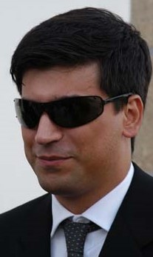
Who Am I Let’s OSINT me ☺
Just got a name
Pedro António Oliveira Vieira
Google (link)
Google “Improved Search” (link)
Google “Improved Search” (link)
LinkedIn (link)
Public profile was showing way too much
Certified Ethical Hacker (link)

Slide 10
Search Engines Internet is more than Google
Different search engine → different rules/crawlers → different results
Google (link)
Bing (link)
Yahoo (link)
DuckDuckGo (link)
Baidu (China) (link)
Yandex (Russia) (link)
You may ask to be removed from one search engine, not all ☹

Slide 11
Google Dorks Commonly used searches
Google Advanced Search (link)
Google Hacking Database (link)
gbhackers (link)
google-dork-list (link)
Google Advanced Operators Guide (link)
Google Advanced Operators Reference (link)

Slide 12
Search operators Improve the search
filetype: search your results based on the file extension
cache: This operator allows you to view cached version of the web page.
allinurl: This operator restricts results to pages containing all the query terms specified in the URL.
inurl: This operator restricts the results to pages containing the word specified in the URL
allintitle: This operator restricts results to pages containing all the query terms specified in the title.
link: This operator searches websites or pages that contain links to the specified website or page.
info: This operator finds information for the specified web page.
location: This operator finds information for a specific location.
42 Advanced Operators (link)

Slide 13
Awareness

Slide 14
Internet Search Pay slip
Don’t open links just because they are available.
It’s like entering a house just because the door was open. Would you do that ?
Google Search (link) (link)
Bing Search (link)
Yahoo Search (link)
“recibo de vencimento” filetype:pdf
“recibo de vencimento” – keywords to look for
filetype:pdf - only pdf files
Available information on pay slips
Full name, address, nif, nib, marital status, number of children, ...

Slide 15
Internet Search Hacked Websites
Google Search (link)
allintitle:“hacked by” site:pt
“hacked by” - keyword to look for
site:pt - only “portuguese” sites (registered portuguese domains)
About 13.400 results
Sites / pages that were “tagged”/”signed”
Attack and contents changed to show off skills (mainly kids) – compared to street tagging

Slide 16
Internet Search Curriculum Vitae
Google Search (link)
Google Search - List site/directories contents (link)
“curriculum vitae” filetype:pdf inurl:upload
“curriculum vitae” – keywords to look for
filetype:pdf - only pdf files
inurl:upload
Curriculum Vitae
Sending CV with too much information – what is too much ☺
Home address – Street View
Professional information phishing
Fake job adds (Is this a thing?)
Notes:
Check cache instead of opening the link

Slide 17
True stories Healthy Meal
Someone posted a photo of healthy meal during COVID
Working remotely on in the usual business environment
Company laptop was in the background
Zoomed in and was possible to read emails
Company private information could be leaked
Personal information on other persons was showing
Social Media Apps use OCR
Means they also read the emails
And everyone else on that social media could get the same information

Slide 18
True stories Quiet vacations
Long last deserving vacations
Too many friends at destination
So, warn no one and just relax on vacations
I posted a picture on social media
My friends were alerted I was nearby
Friends on that location called me on the phone
Everyone else knew I was not home
Burglars love that kind of information
Not public profile. At least I think it is not (rules change)
Someone could have shared the photo with the world

Slide 19
True stories Store Credit
Buying a book for almost no money
How I was able to get money just by having the right information
Store clerk asked for store customer card
Gave mobile number and full name
Store clerk asked if I wanted to use balance credit
I accepted and little had to pay
Mobile and full name were not mine ☺

Slide 20

AITI Changing Customer Data

Slide 21
Who are YOU Search yourself
Search your name on Google and analyze the results
As you saw the search can be improved
Some results can/will include:
Family and Friends
Work
School grades
BI - Identity Card Number (yes)
NIF – Tax Identification Number
That is typically information to verify your identity over a phone call.

Slide 22
Awareness Personal Information - The internet sees you
Posted information can get publicly and world available
Even private profiles can have their data shared by others
When information is posted
Shows where you are at that time (habits & routines)
Information on the picture
Metadata
Geolocation

Slide 23
Awareness Life is hard
What companies know about us (link)
Awareness
What do we teach our kids? Do we teach ?
They are exposed to everyone on the internet.
Social Media accounts
If you don’t have Facebook, I can create one in your name and call your friends

Slide 24
Awareness Browser F12
1 - Type url on browser
2 - Page is requested from the internet
3 - Page is displayed from local data (previously downloaded)
Show password text on password field
Did you ask for a screenshot
Let me just change some data

Slide 25
Deadly Social Media The Final Hours of Pop Smoke
Rapper Pop Smoke Murdered in Home Invasion ... By 4 Masked Gunmen (link)
Instagram Posts
Location Tag
Geolocation
Reverse Image
Google Maps
Local Recon
Airbnb/Zillow (Rent/Real-estate)
House photos (Outside and Inside)
Layout
YouTube Video: The Cyber Mentor (link)

Slide 26
OSINT PT

Slide 27
OSINT Portugal – Public contracts
Base (link)
The example (link)
PDF of contract with PII strikethrough (link)
Open with pdf reader and delete the strikethrough boxes
Name of employee who edited the document
Information on UA, LinkedIn, Facebook, …
Metadata: “KONICA MINOLTA bizhub C454”
Information leaked
Full Names, nif, addresses

Slide 28
OSINT Portugal – Vehicle Information
Automóvel On-line (link)
Certidão Permanente Automóvel (link)
License Plate : “89-QS-04” (link)
Result
Brand: MERCEDES-BENZ
VIN: WDD2221631A248762
Example (link)
Vehicle Information (link)
Example (link)
Information: Brand, Model, Location, Paint, Delivery Date, Extras, …
Hack across the globe by VIN (link)

Slide 29
OSINT Portugal –Insurance Information
ASF – Autoridade de Supervisão de Seguros e Fundos de Pensões (link)
Example (link)
License Plate : “01-EF-34”
Date : “03-07-2022”
Example 2 (link)
License Plate : “01-EF-34”
Date : “03-07-2012”
Insurance Company
Current and Past
Length of the contract
Insurance policy number
Is it possible to get information for all license plates ????

Slide 30
OSINT Portugal Specific
Registo Predial Online (link)
DGES - Direção-Geral de Ensino Superior (link)
DRE - Diário da República (link)
Search DRE (link)
Finanças - Penhorados (link)
Example (link)
Search Penhorados – (link)
Ministério da Justiça - Penhorados (link)
Plataforma Eletrónica de Compras (Administração Pública) (link)
Leaked information:
Full Names, Addresses, NIF, Company, Marital Status, …

Slide 31
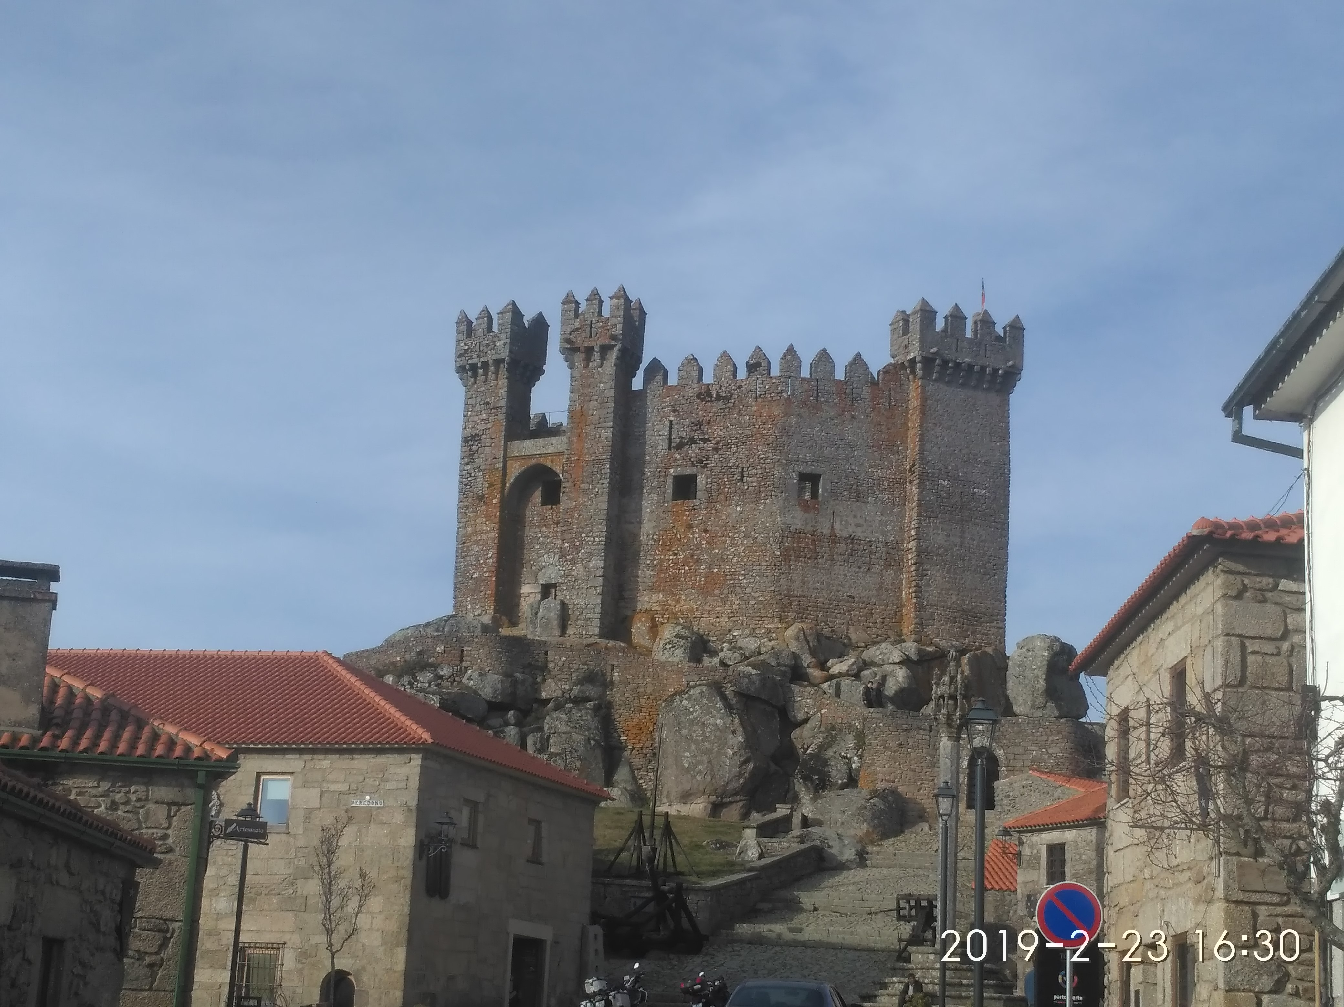
OSINT - Photos Lots of Information
Where was this image taken?
Have you been there?
When?
Date stamp on photo
Filename with date
Metadata
What else?
Image search
Identify the castle?

Slide 32
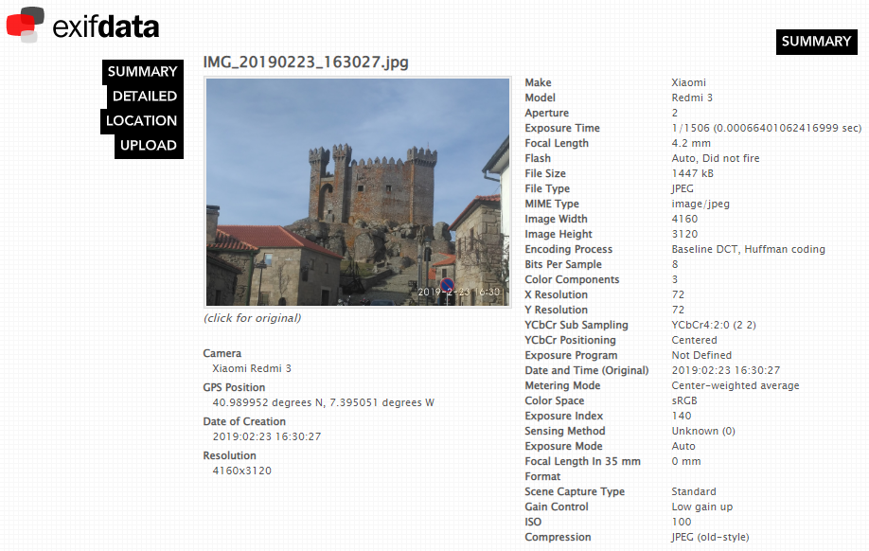
OSINT - Photos Metadata
Metadata
GPS (link)
Google Maps (link)

Slide 33
OSINT (Reverse) Image search
One image is worth 1000 words, maybe more.
What information can be extracted from a photo ?
Google Images (link)
Bing Images (link)
Yahoo Images (link)
Tineye (link)
Yandex (link)
The professionals (video explaining) (link)

Slide 34
OSINT Street View
Google Street View (link)
Identify house by address
Assess security (cameras, fences, ...)
Parked cars (timeline, ...)
People’s habits/routines, timetables, ...
View the past – timeline (link)
Instant Street View (link)

Slide 35
Search Satellite View
Zoom Earth (link)
Satellites Pro (link)
World Imagery (link)
Wayback (link)
Wayback example (link)
View the past - timeline

Slide 36
Wayback Machine Internet in the past
Wayback Machine (link)
Example (link)
Archive.is (link)
Cached Pages (link)
Cached View (link)
OldWeb.Today (link)
Time Travel (link)
Github commits ☺

Slide 37
Databreach

Slide 38
Databreach Is not a thing of the past
Troy Hunt
HaveIBeenPwned (link)
Pwned websites (link)
Ashley Madison Breach 2015 (link)
When private data gets public
Piracy - Subtitles
Don’t think you can hide – Illegal activities are tracked
Companies are leaking all your information
Compromised data: Dates of birth, Email addresses, Employers, Family structure, Genders, Income levels, Living costs, Marital statuses, Mothers maiden names, Names, Phone numbers, Physical addresses, Places of birth, Religions, Spouses names

Slide 39
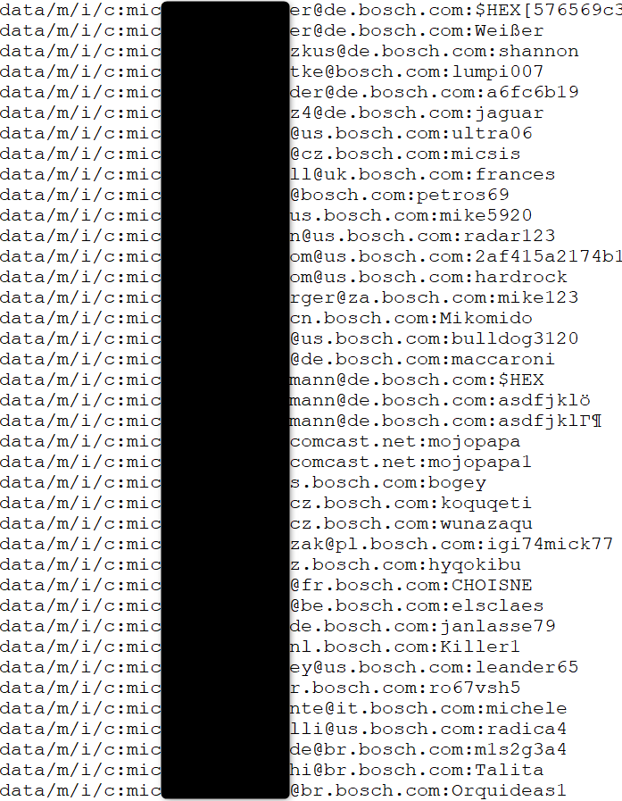
Databreach Company credentials ?
Email/Login
Password
Source
Publicly available list of credentials
More than 10k credentials just for Bosch
Information gathered
Rule of email/login
(FirstName.LastName)@(Country).(company).com
Rule of password complexity
List of users
Phishing campaigns
Brute force
Look for those users on Social Media
HaveIBeenPwned (link)

Slide 40
SHODAN

Slide 41
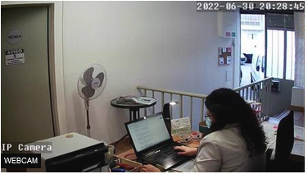
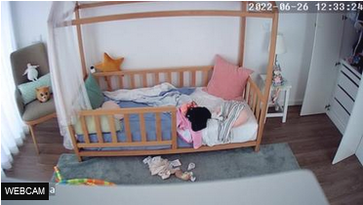
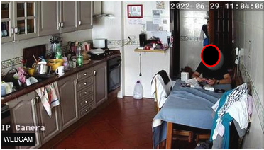
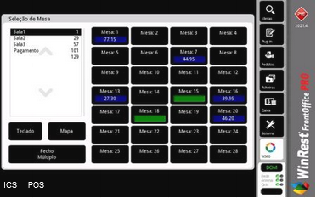
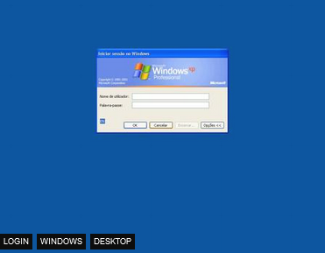
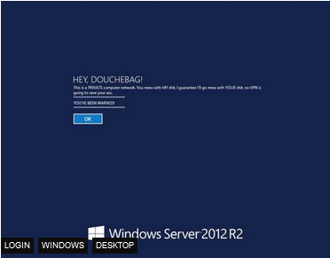
Shodan Internet of Things - Images

Slide 42
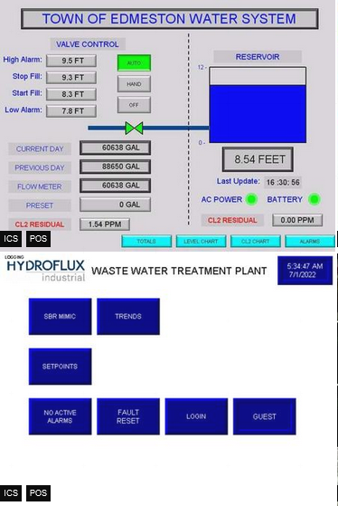
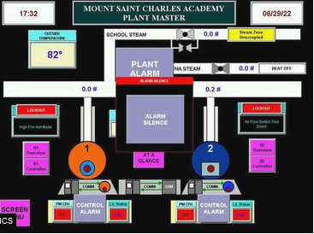
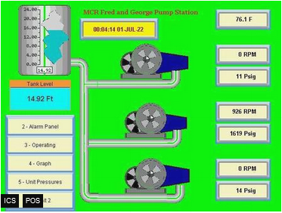
Shodan Industrial Control Systems
Industrial Control Systems (link)

Slide 43
ONLINE SAFETY

Slide 44
Helping Tools Privacy
VPN (Different country, different advertisements, what else ?)
ProtonVPN (link)
Temporary Email (Need to register? Activate software?)
10 minute email (link)
20 minute email (link)
Disposable Email
60 minute email (link)
Internet Access (DarkWeb included)
Tor (link) (internet browser)
Tails (link) (OS that runs on usb or VM)

Slide 45
Helping Tools Safety
VirusTotal
Check received files (link)
(don’t upload Personal or Company related information)
Netcraft
Sitereport (link) (check for suspicious sites)
Ransomware
No More Ransom (link)
Virtual Credit Card (online shopping)
Mbnet (link)
Revolut (link)
PayPal (link)

Slide 46
Helping Tools Reverse Tracking
Gmail Plus Address (link) example email: mypersonalemail@gmail.com
If you append a “plus” sign to your email username, Gmail will ignore anything written between the + and @ sign in the email address and still deliver the message to the same mailbox.
Any email address sent to
mypersonalemail+linkedin@gmail.com
mypersonalemail+continente@gmail.com
mypersonalemail+financas@gmail.com
Will still reach the Gmail inbox of mypersonalemail@gmail.com inbox though, technically, they are three different email aliases.
Know who is sharing your email ☺

Slide 47
Free to Share

Slide 48
License
Feel free to use/modify/share
Teach someone
Improve awareness

